Slide 1



AI-Driven Electricity Price Forecasting for Energy Arbitrage
A "Green Skills" Project for the Shell-Edunet Skills4Future AICTE Internship
Presented By : Sanjana Sudhakar Dhabale
AICTE Student ID : STU676abeff89ab11735048959

Slide 2

Learning Objectives
Apply Machine Learning (XGBoost) to solve a complex, real-world time-series forecasting problem.
Build an end-to-end ML pipeline : Data Preprocessing → Feature Engineering → Model Training → Evaluation.
Simulate a complex business logic (arbitrage) using the model's predictions to evaluate financial performance.
Evaluate the model using key regression metrics (RMSE, MAE) and the business case using financial metrics (Total Profit).
Deploy the complete system as a live, interactive web application using Streamlit.
GOAL
Source :
www.freepik.com/

Slide 3
Tools and Technology used
Programming Language : Python
Data Handling : Pandas & NumPy (For data manipulation, cleaning, and processing).
Machine Learning :
  Scikit-learn : For data splitting and StandardScaler (feature scaling).
  XGBoost : The high-performance gradient-boosting model used for price forecasting.
Visualization : Matplotlib, Seaborn, and Plotly (For interactive charts in the app).
Deployment : Streamlit (For building and hosting the interactive web application).
Model Management : Joblib (For saving and loading the trained model and scaler files).

Slide 4
Methodology
Week 1 : Data Engineering & Exploration
Task : Data Importing, Pre-Processing, and Visualization.
Action : Loaded and cleaned 4 years of historical energy data. Engineered new time-based features (Hour, Day, Month) to capture trends. Analyzed data to confirm price volatility and arbitrage potential.

Slide 5
Methodology
Week 2 : Model Building & Evaluation
Task : Model Selection & Building.
Action : Split data into Train/Test sets. Trained and compared Linear Regression (as a baseline) against an XGBoost Regressor. Selected XGBoost as the final model and saved it (model_price_forecast.joblib).

Slide 6
Methodology
Week 3 : Simulation & Deployment
Task : Model Evaluation, Optimization, and Final Submission.
Action : Built an "Energy Arbitrage" simulator using the model's predictions. Developed a "Buy/Sell/Hold" logic that generated a positive profit. Designed and deployed the final Streamlit web app.

Slide 7
Problem Statement
Electricity prices in competitive markets change rapidly based on demand, generation, and weather. Without predictive insights, energy consumers and battery storage operators cannot optimize when to buy, store, or sell electricity. This leads to high operational costs, grid inefficiency, and financial loss.

Slide 8
Solution
An AI-driven system that forecasts short-term electricity prices with high accuracy. The system uses these forecasts to power a simulation of an energy arbitrage strategy. This provides a clear decision-making tool (deployed as a Streamlit app) that recommends when to "Buy" (charge a battery), "Sell" (discharge), or "Hold" to maximize profit.

Slide 9
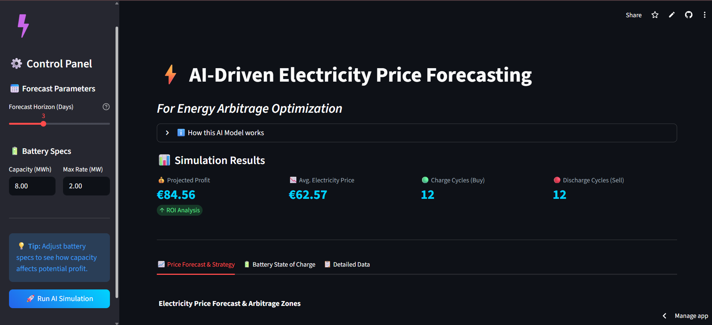
Screenshot of Output
The Live Application

Slide 10
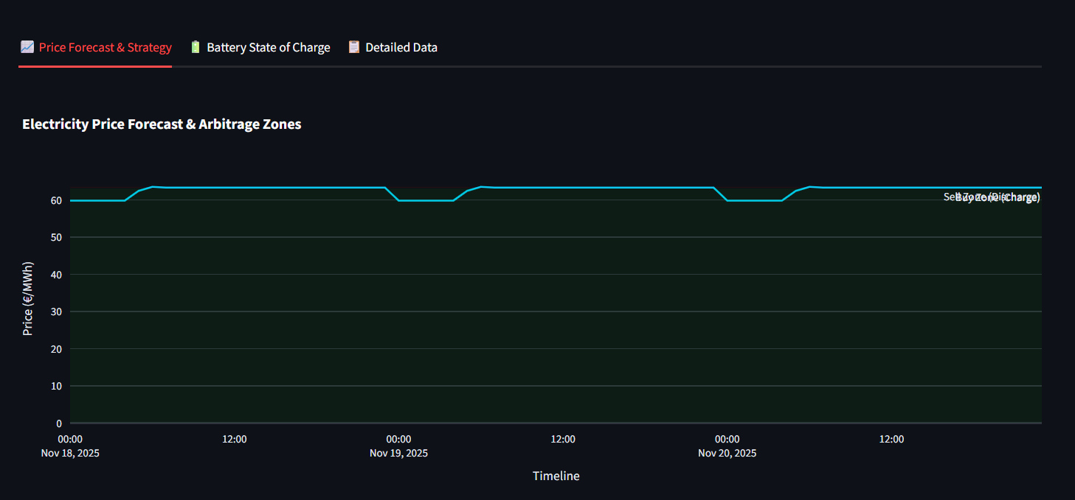
Screenshot of Output
The Live Application

Slide 11
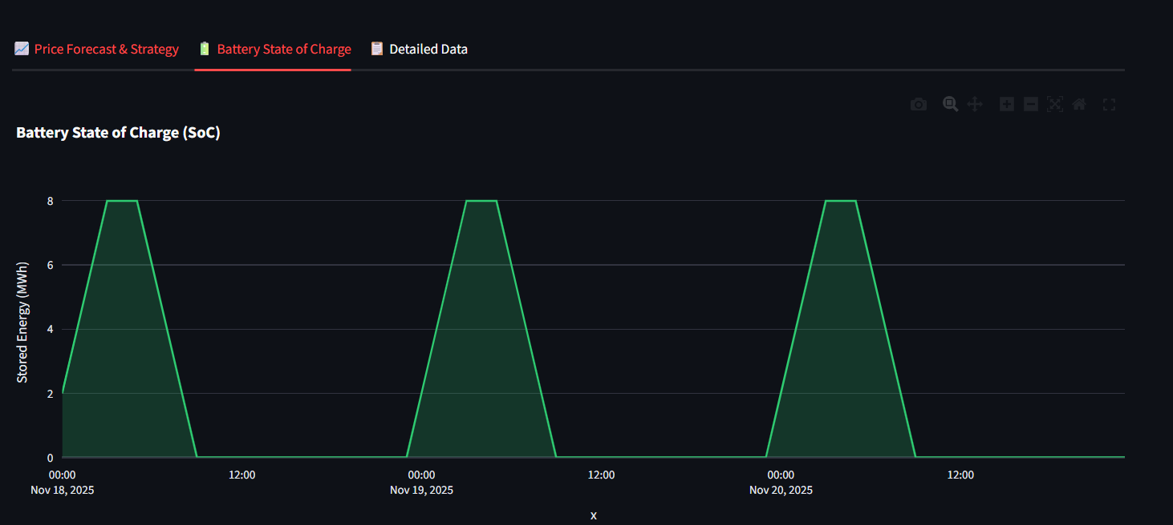
Screenshot of Output
The Live Application

Slide 12
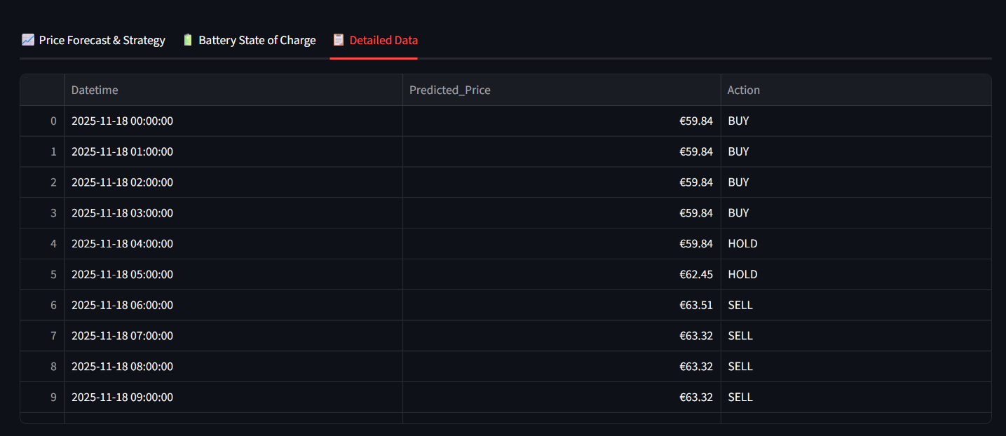
Screenshot of Output
The Live Application

Slide 13
Conclusion
Impact : This project successfully demonstrates that AI-driven forecasting can create tangible financial value in the energy sector. It provides a "Green Skills" solution by optimizing battery storage, which in turn reduces energy costs and promotes grid stability.
Educational Value : I successfully built a complete end-to-end ML pipeline, from raw data cleaning and feature engineering to model training, complex simulation, and finally, deployment of a live web application.
Next Steps :
Integrate live weather data (e.g., cloud cover, wind speed) via an API to improve the model's forecasting accuracy.
Enhance the arbitrage logic with more complex, real-world battery constraints (e.g., C-rate limits, degradation cost).
Live App Link : https://ai-electricity-price-forecasting-arbitrage.streamlit.app/
Project Repository : github.com/Sanjana-Dhabale/ai-electricity-price-forecasting

